Slide 1

Data Golf 2026
SNOMED CT EXPO 2026 · LIGHTNING TALK
A community analytics challenge
- learnings and insights
Matt Cordell
John Grimes
· Australian e-Health Research Centre
Notes:
Data Golf was a free Kaggle competition: 18 yes/no clinical questions over a synthetic SNOMED CT-coded dataset. Today I’ll be going over the what we can learn from the submissions and strategies used, because the patterns are ones every analyst working with coded data will encounter.

Slide 2
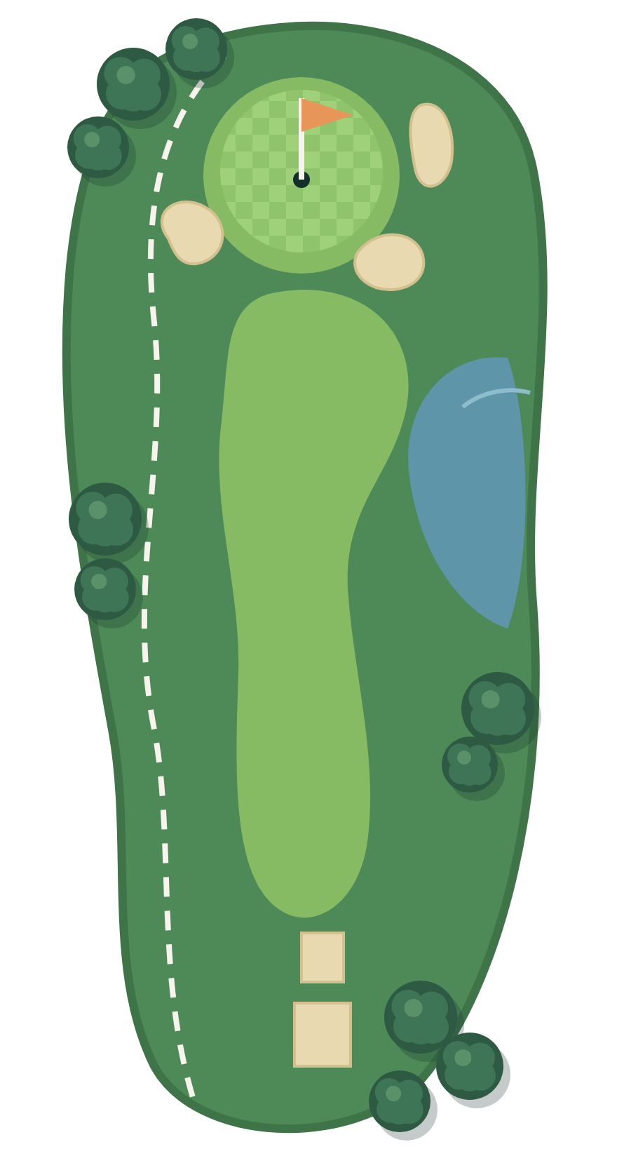
The Competition
279,912
synthetic patient encounters, 2021 to 2026
6
SNOMED CT-AU editions; each encounter answered with the edition of its date
18
yes/no questions, scored by macro F1
13
complete submissions (15 received)
0.0024
macro F1 between the top three (0.9922, 0.9914, 0.9898); ten of 13 scored above 0.91
Notes:
We picked questions where the terminology moved between editions, and over-sampled codes that were later retired, so drift would show.
Those retirement rates are by design, not necessarily what you would see in real data.
Scoring was macro F1: for each question, how well your Trues match the key, penalising both misses and false alarms, averaged over the 18 questions.
The top three finished within a quarter of a percentage point. So the interesting question is where everyone else lost points.

Slide 3
The course: 18 “holes”
Q1
Female as recorded sex
Q10
Bilateral condition
Q2
BMI 30+ and cholesterol:HDL above 5
Q11
Female 15 to 49 on methotrexate
Q3
Healthy or no current problems
Q12
Pregnant and on a teratogen
#1
Q4
Hyperthyroidism per clinical note
Q13
OA or RA, oral NSAID, eGFR below 60
#5
Q5
Osteoarthritis in 2024
Q14
Upper limb wound, not fingers/thumb
Q6
Taking an ACE inhibitor
Q15
Pregnant, fasting glucose 5.1+ mmol/L
#2
Q7
Taking a cardiac glycoside
Q16
Non-Strep bacterial joint infection
#4
Q8
Fungal foot infection
Q17
Taking an oral iron supplement
Q9
Two or more paracetamol products
Q18
Mineral supplement, not Na, K or Cl
#3
Dark rows: the five holes where teams disagreed most, ranked #1 to #5.
Notes:
These were the questions that participants were asked to answer.
The five dark rows are where the teams disagreed most: the two pregnancy questions, mineral supplements, the bacterial joint infection and arthritis with an NSAID and low eGFR.
The rest were largely par for the course.
I’ll

Slide 4
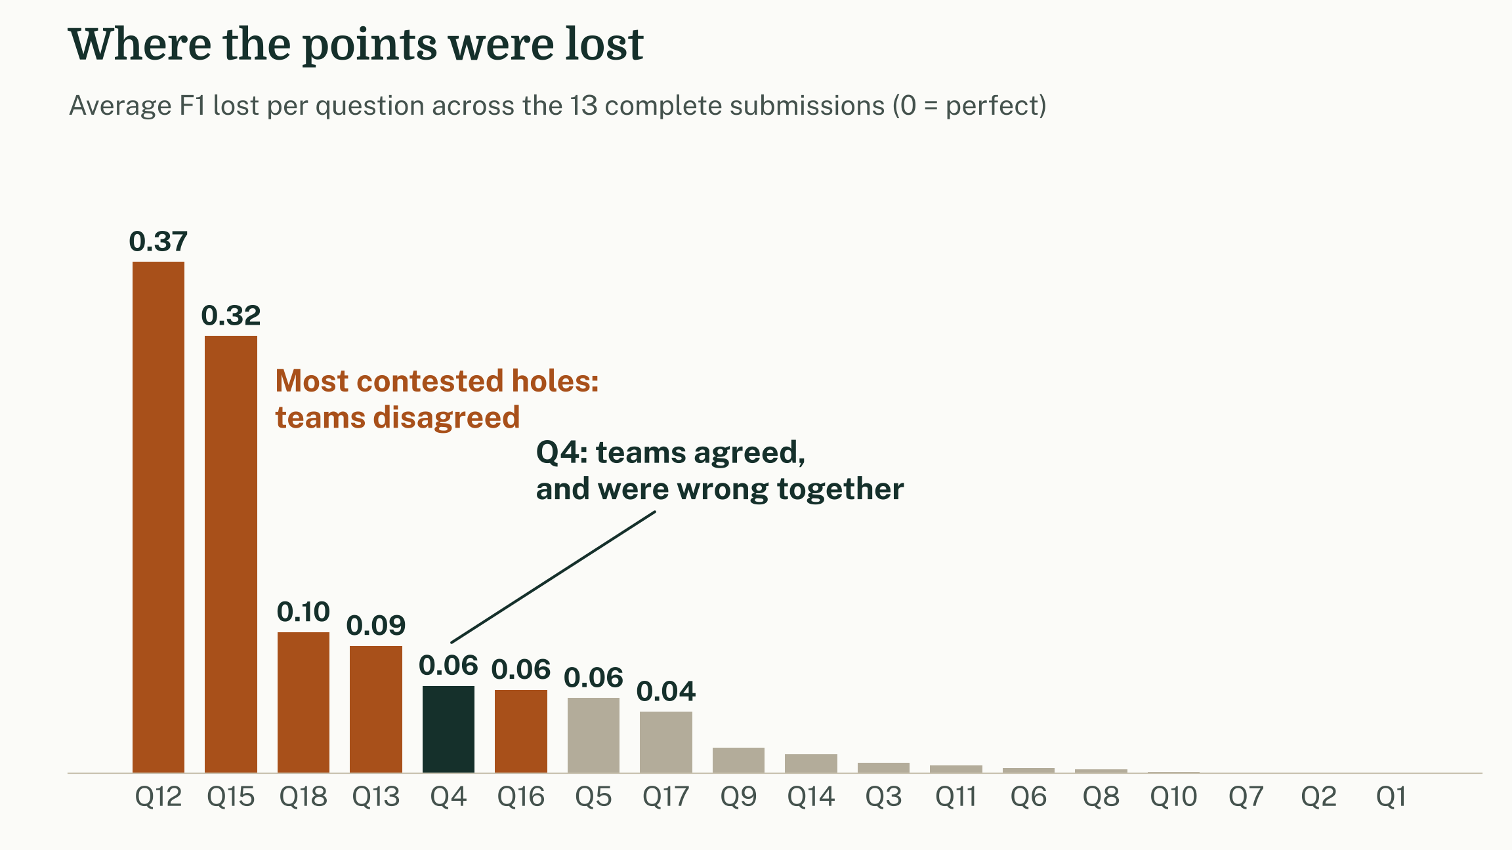
Most holes were par. Five decided the round.
Q1, Q2 and Q7: every team perfect.
Losses sit in the two pregnancy questions, mineral supplements, joint infection and arthritis with NSAIDs.
But the biggest shared mistake, on Q4, was not contested at all.
Notes:
Each bar is the average F1 lost on a question. Most holes were par for everyone.
The losses concentrate where teams disagreed: the two pregnancy questions, Q18 mineral supplements, Q16 joint infection and Q13 arthritis with NSAIDs.
Q12, the hardest hole, needed a home-made teratogen list, because the SNOMED CT teratogen concept has no subtypes.
But disagreement only shows you where teams differ.
A notable observation from Question 4 is nine teams agreed and were wrong together, and you only find that by asking whether the definition itself is right; so that’s where I will start.

Slide 5
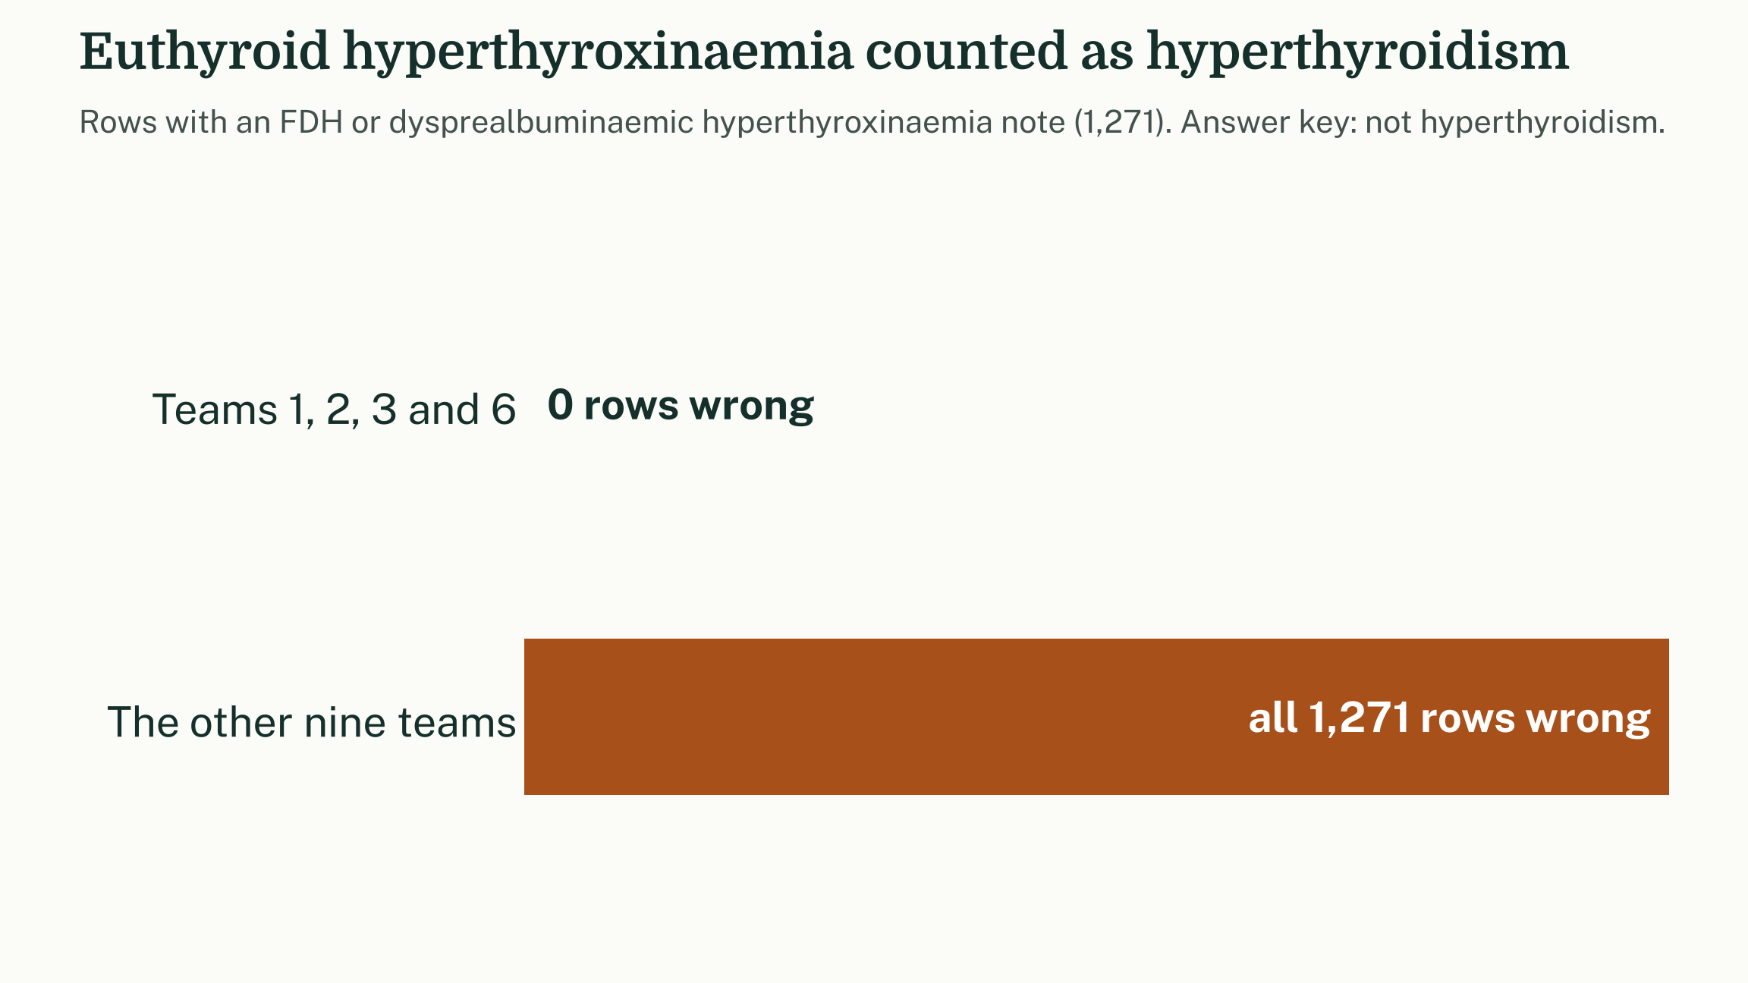
The hierarchy said yes. The clinician says no.
Q4 · HYPERTHYROIDISM
9 of 13 teams counted familial dysalbuminaemic hyperthyroxinaemia as hyperthyroidism.
It sits under Hyperthyroidism, but patients are euthyroid [1,2].
Seven teams gave an identical answer column.
[1] Pappa T, et al. Best Pract Res Clin Endocrinol Metab 2015;29:735-47. doi:10.1016/j.beem.2015.09.002
[2] Kragh-Hansen U, et al. Front Endocrinol 2017;8:297. doi:10.3389/fendo.2017.00297
Notes:
Q4 asked for hyperthyroidism according to the clinical note. 1,271 rows carry familial dysalbuminaemic hyperthyroxinaemia, FDH, or its transthyretin cousin.
Both sit under Hyperthyroidism in the hierarchy, so a plain descendants query picks them up. But these patients are euthyroid: a variant binding protein raises measured total T4 while TSH is normal.
The FDH literature warns specifically against treating them as hyperthyroid. Nine teams said True on every one of those rows, and seven produced an identical answer column, which suggests essentially the same query.
Subsumption answers the question the hierarchy asks, which is not always the clinical question.

Slide 6
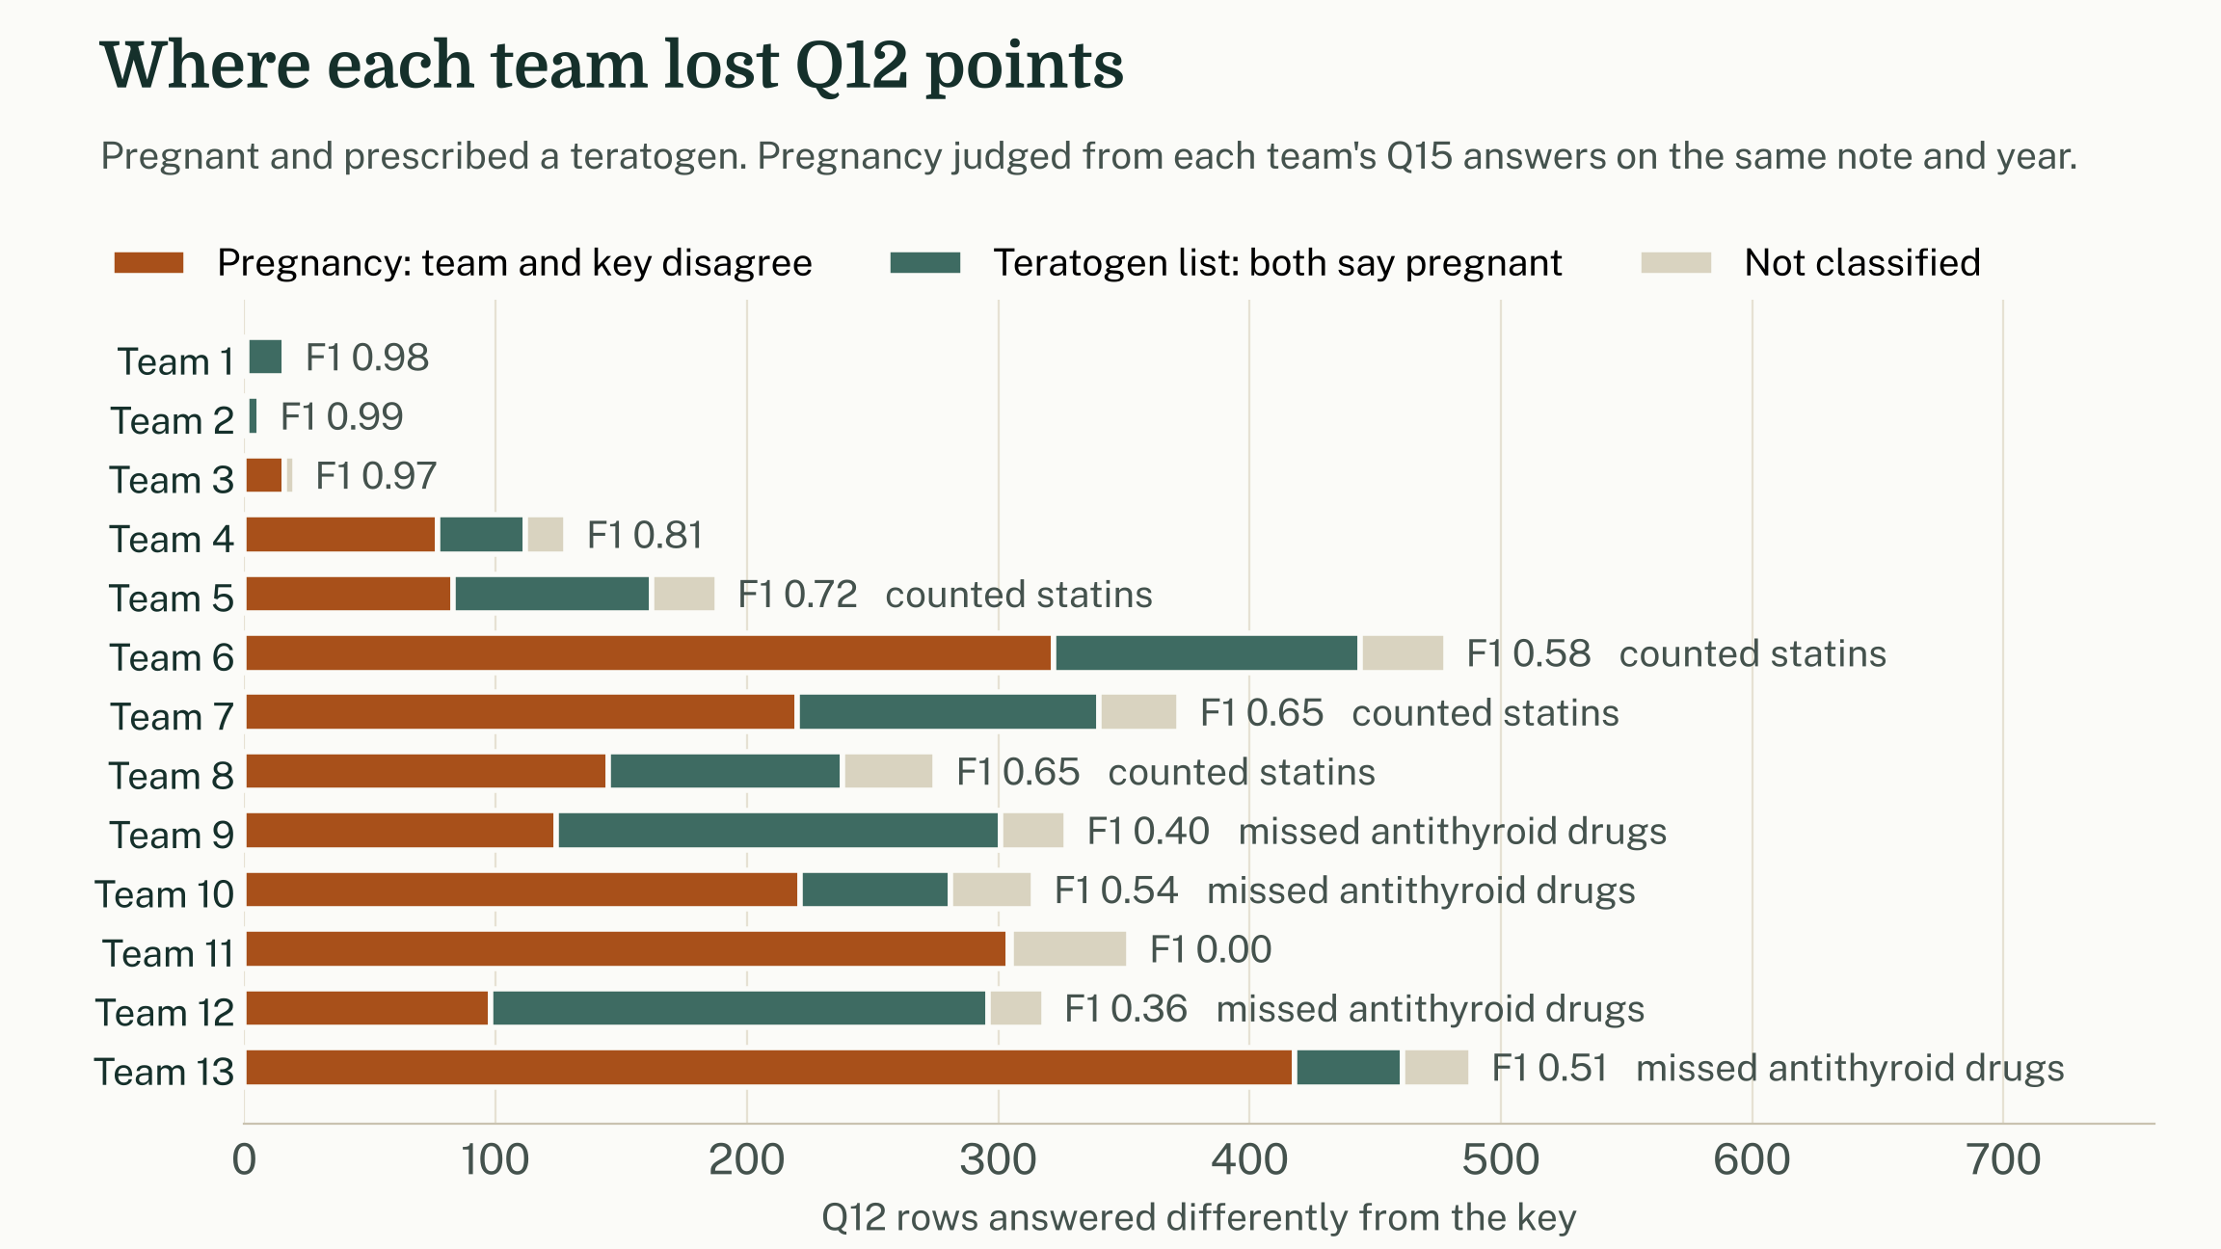
No ECL returns a teratogen
Q12 · PREGNANT AND PRESCRIBED A TERATOGEN
45986006 |Teratogen| has no subtypes, and no substance is defined by the teratogen disposition. Every team built its own list.
Still, pregnancy cost more: about 60% of Teams 4 to 13's errors.
The lists split: four teams added statins; four missed antithyroid drugs.
Notes:
Question 12 has two hard halves. The teratogen half comes first.
SNOMED CT has a substance concept, Teratogen (45986006), defined by a teratogen disposition.
It has no subtypes.
No substance in the AU edition carries that disposition, so an ECL on it returns no products at all.
Every team had to notice this and build its own list.
The chart splits each team's errors:
Where a team's own Q15 answers show it disagreed with the key about whether the note means pregnant, I count that as a pregnancy error.
Where both agree the patient is pregnant, the error is in the teratogen list.
Across Teams 4 to 13, about 60 percent of errors are pregnancy errors and about 30 percent are list errors. Pregnancy was the harder half, as we expected.
The lists differ in interesting ways:
Four teams counted statins as teratogens. Older labelling did contraindicate them in pregnancy, although a large cohort study found no significant malformation risk after adjustment.
Four teams missed carbimazole and propylthiouracil. Both are associated with birth defects and are a recognised first-trimester concern.
Neither choice is in SNOMED CT. Both are decisions someone has to make and write down.
The attribution assumes each team used the same pregnancy rule for Q12 as for Q15.
About 9 percent of error rows cannot be classified.
References:
Bateman et al., BMJ 2015, doi 10.1136/bmj.h1035
Alexander et al., Thyroid 2017, doi 10.1089/thy.2016.0457

Slide 7
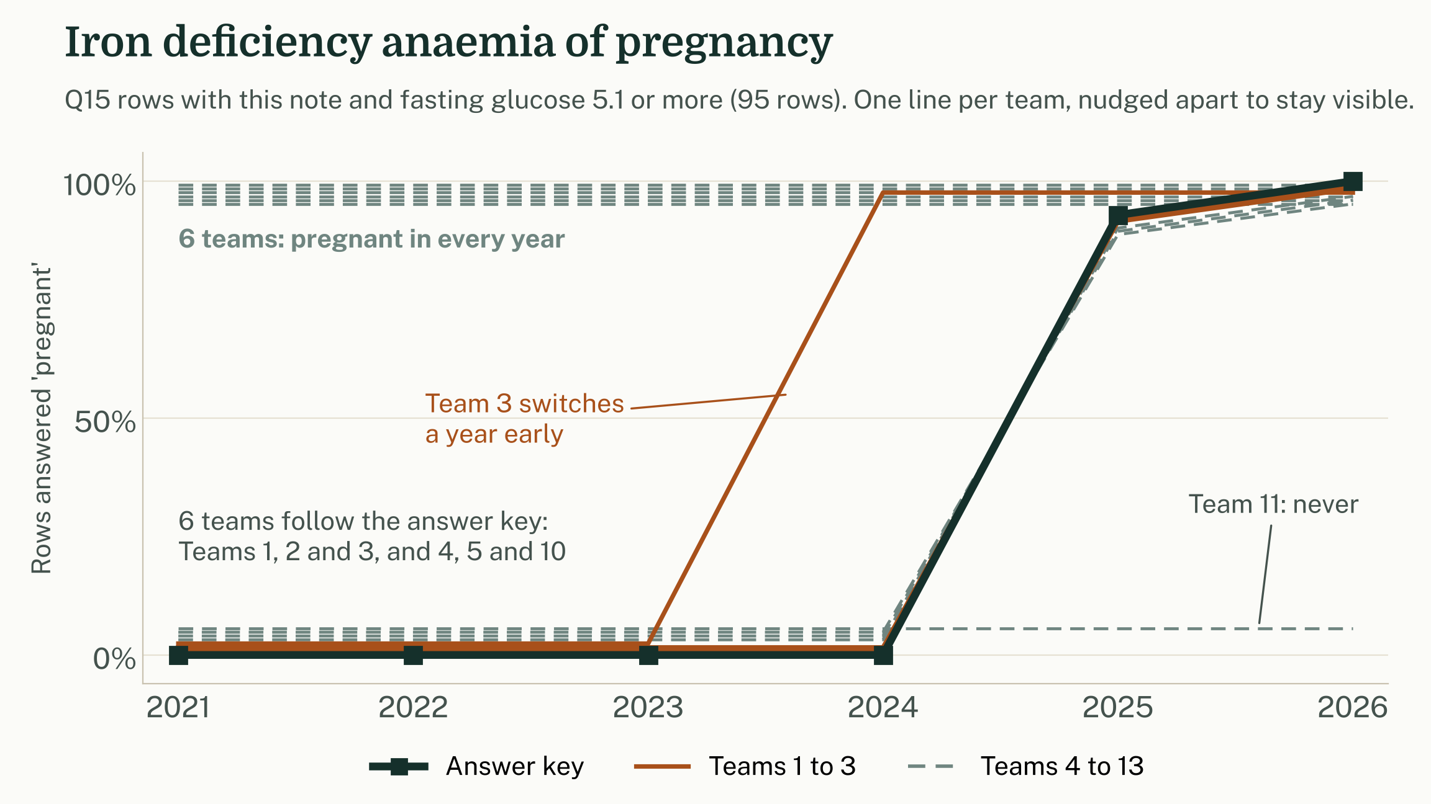
Right by the rule, wrong in the clinic
Q15 · PREGNANT WITH HIGH FASTING GLUCOSE
Four approaches to one concept.
Our key used << Finding related to pregnancy. Until 2025 this concept had no pregnancy parent, so the key missed it.
Six teams said pregnant every year: clinically right, scored wrong.
199248002 |Iron deficiency anemia of pregnancy (disorder)|
Notes:
Pregnancy was the hardest part of the competition.
This chart shows one concept: iron deficiency anaemia of pregnancy, with one line per team.
The black line is our answer key. It says not pregnant until the 2025 edition, then pregnant. This is our miss.
The key used descendants of "Finding related to pregnancy", applied with the edition current at each encounter.
Until the 2024 edition, this concept's only parents in SNOMED CT-AU were haematology concepts. Nothing linked it to pregnancy.
So the key was correct by its own rule, but the rule was not good enough.
The teams fall into four groups:
Six teams, including the top three, followed the same rule as the key, edition by edition.
Team 3 switched a year early.
Team 11 never counted it.
Six teams said pregnant in every year, which is the clinically right answer, but were marked wrong for 2021 to 2024.
The last six were probably working from a later edition rather than deliberately correcting for the gap, but they got it right.
The lesson: a rule that faithfully follows the edition at the time also faithfully reproduces that edition's gaps.
Writing a good pregnancy rule is hard, and we did not fully manage it.
Six other concepts in the data also switch from not pregnant to pregnant in the key between editions, including severe pre-eclampsia.
Treat this as an example, not a one-off.

Slide 8
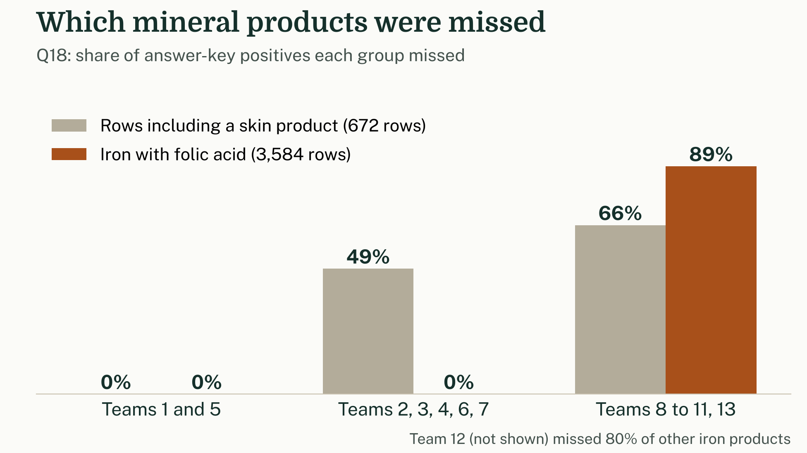
Asked for supplements, scored on ingredients
Q18 · MINERAL SUPPLEMENT
WHAT TEAMS DID
The key counted zinc oxide nappy cream. Five teams dropped about half of the rows with a skin product.
Another five missed 90% of iron with folic acid products. Two teams got everything.
WHY IT WAS HARD
The question was silent on specific dose forms.
373460003 |Mineral supplement| has subtypes, but none are used as ingredients of any product.
Participants had to research their own list. ATC A12 is a reasonable start.
|Is modification of| links some salts to their element but not others (zinc oxide, ferrous sulfate), so query products, not substances.
Notes:
Mineral supplement was ambiguous by design. The wording follows ATC A12.
The SNOMED CT Mineral supplement substance has subtypes, but no product uses them as an ingredient, so participants had to build their own list.
The key follows the ingredient, and the question named no dose form. So a zinc oxide nappy-rash ointment counts.
Reading the question by clinical intent would drop those products.
Starting from the element misses compounds. For example, “is modification of” links ferrous fumarate and zinc sulfate to their element, but not ferrous sulfate or zinc oxide.
Going through product ingredients is more reliable.
In hindsight, our key should have excluded skin products. A supplement is (almost exclusively) taken by mouth or by injection, and a nappy-rash ointment is neither.
Most teams read it that way.
The definition was the hard part, not the query.

Slide 9
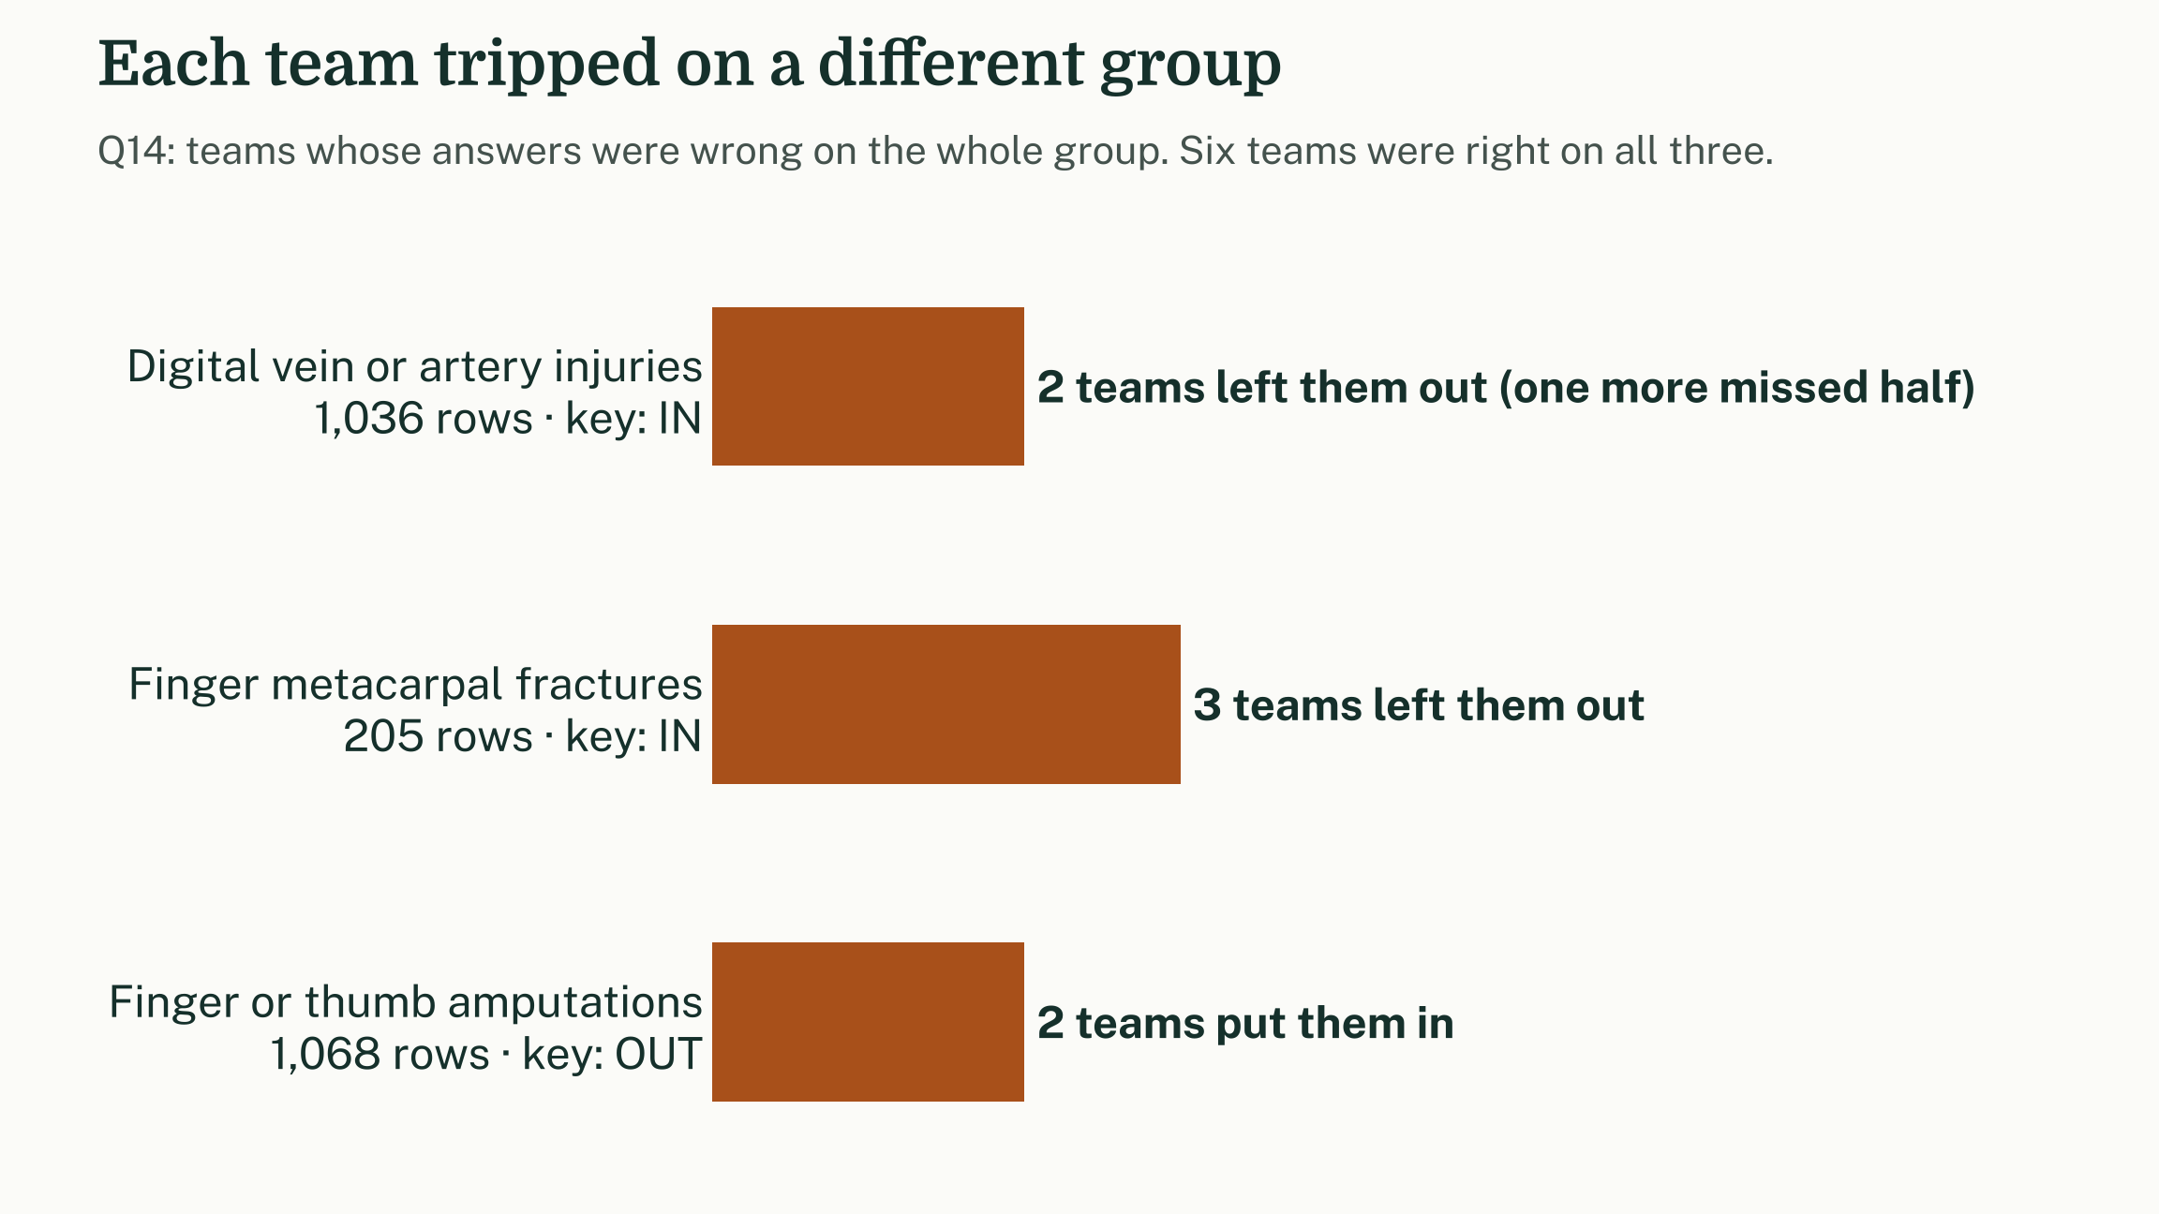
Words in the name are not the model
Q14 · UPPER LIMB WOUND, NOT FINGERS OR THUMB
Digital vessel injuries and finger metacarpal fractures are in.
Thumb and finger amputations are out.
Six teams were perfect; the rest each tripped on a different group.
Notes:
Q14 was par 3 and was mostly played that way, but the errors fall in a revealing pattern.
The answer key works from the modelled finding site. A finger metacarpal fracture is in the hand, so it stays in. Digital vessel injuries stay in. Traumatic amputations of fingers are out.
You could argue that a digital artery injury is a finger wound. That is the point: the model makes a choice, and the key follows it.
Teams that filtered on the words "finger" or "digital" went wrong in both directions. Some included items the model places outside the finger, and others excluded items it places inside.
No error was shared by more than three teams, so this was not a single systematic misreading. It was spread across individual string-matching decisions.
The lesson: use the attributes, not the strings, and know what the model decided.

Slide 10
1 Pick an edition strategy. Each one fails differently.
FOR YOUR NEXT LONGITUDINAL ANALYSIS
Encounter edition
Latest edition
Every edition
Keeps codes retired since, as they were meant then.
Keeps today's corrected modelling.
Keeps both of the above.
Loses retired codes. Q5 falls from 3,819 positives to 748, even with HISTORY-MAX.
Inherits what was later moved out for good reason, such as Thyrotoxicosis from Hyperthyroidism.
Inherits that edition's gaps: anaemia of pregnancy was not pregnancy until 2025.
Whichever you choose, write it down and test it on the codes that changed.
2 Expand and read your value sets. A descendants query inherits every editorial decision under the parent.
3 Query attributes, not words. Finding site, causative agent, ingredient and dose form are usually more robust than a string match.
4 Write the definition before the ECL. "Pregnant" and "mineral supplement" are decisions, not queries.
Notes:
If you take one thing from today: there is no neutral way to query longitudinal SNOMED CT data.
There are three common strategies, and each fails in a different way.
Encounter edition: query each encounter against the edition current at the time, as our answer key did.
This keeps codes that have since been retired.
It also inherits that edition's gaps. We saw this with iron deficiency anaemia of pregnancy.
Latest edition: query everything against the latest edition.
This gives you today's better modelling, but you lose retired codes.
On Q5, positives fall from 3,819 to 748, even with the most generous history supplement.
All editions: query against every edition at once.
This keeps both retired codes and the modelling gaps they came with.
It also inherits anything that was later moved out for a good reason, such as Thyrotoxicosis leaving Hyperthyroidism in 2022.
Hybrid: use the latest edition for active codes and the encounter edition for retired ones.
This may get the best of both, but we have not tested it.
Whatever you choose, write it down and check it on the codes that changed.
Three smaller lessons:
Expand and read your value sets.
Query the model's attributes, not words in the term.
Write the definition before the ECL, because that is where the real disagreement lives.

Slide 11

Thank you for playing
1ST · WINNER
2ND
Womp Ratter
Kenny-Bytes
3RD
Joss Markham and Dougal Fleming
Ken Lee
Marcus Baw
0.9922 macro F1 · top of the private leaderboard
0.9914 · top of the public leaderboard
0.9898 macro F1
dedalus.com
makoha.ai
GitHub: pacharanero
YouTube: Everything Digital Health
Pick an edition strategy, and know how it fails.
Full report, with every question, chart and caveat: kaggle.com/competitions/data-golf-2026
Notes:
Thanks to everyone who entered. It was a photo finish at the end.
Winners: Womp Ratter, Joss Markham and Dougal Fleming from Dedalus take the win. They finished first on the private leaderboard, which Kaggle uses for final standings, and first overall.
Public leaderboard: Kenny-Bytes (Ken Lee, Makoha) led by one ten-thousandth, a photo finish.
Third place: Marcus Baw, of Everything Digital Health, was a clear third.
Takeaway: Pick an edition strategy, and know how it fails.
The full report is on the competition page.
Also thanks to my colleague John Grimes for his assistance throughout this excercise.

